Slide 1
Oman - An emerging leader
on the global
connectivity map
MENOG 24
Date: 4 - 5 December 2024
Grand Millennium Hotel, Muscat
Notes:
Welcome!
Oman has intelligently positioned itself on the global connectivity map and has all the ingredients of becoming a connectivity hub in the region.
Oman is being increasingly viewed as an emerging player in the global connectivity industry, thanks to its strategic location overlooking the Arabian Sea and the Gulf of Oman which is witnessing significant growth and demand for international connectivity and traffic.

Slide 2
Contents
Overview of Oman’s International Connectivity
Trends in Global Connectivity & Infrastructure
Content Providers Driving Growth in International Bandwidth
Key Developments in the Past 5 Years
Regulatory Landscape
International Telecommunications Cables
RAIO
QoS
1
2
3
4
5
Notes:
https://www.fiberatlantic.com/

Slide 3
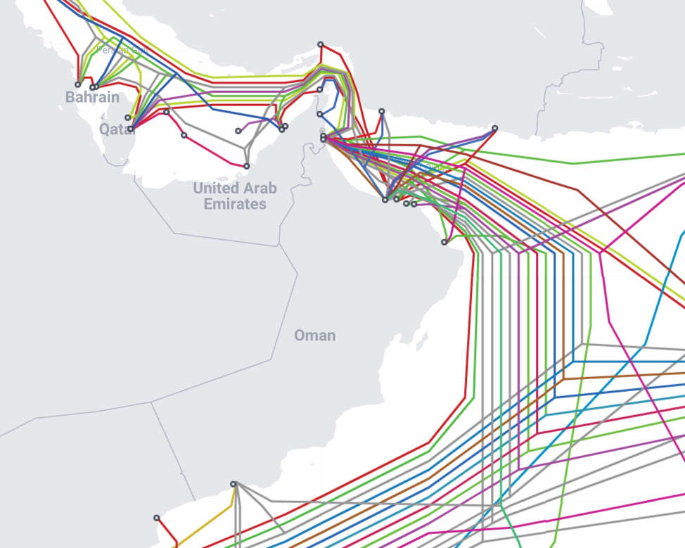
Overview of Oman’s International Connectivity
18+
Cables
7
CLSs
2 CNDCs
40
Hyperscalers & CDNs
6
Upcoming Cables
https://www.submarinecablemap.com/
Notes:
The numbers are testament to the trust and confidence of industry players and investors in the eco-system and state-of-the-art infrastructure that Oman offers for international connectivity on competitive basis.

Slide 4
Trends in Global Connectivity & Infrastructure
A New Cable Boom
Bandwidth Growth
Cloud Infrastructure
Between 2023 and 2025, a new cable boom valued at a record $10 billion will bring an estimated 78 systems online measuring over 300,000 kilometers in length, a level of growth not seen in over 20 years
Since 2018, content providers have added capacity at a faster rate than other bandwidth users. To date, Google and Meta—driven by their bandwidth-intensive requirements for search, video, and social media—have invested in 26 and 15 submarine cable systems, respectively.
After a three-year slump, both mature and emerging markets are rebounding in cloud region expansion. These rollouts can be traced back, in part, to submarine cable routing decisions. Cables land near locations prime for cloud region growth, so cable routes show where inter-data center bandwidth growth is expected.
https://submarine-cable-map-2024.telegeography.com/
Notes:
https://submarine-cable-map-2024.telegeography.com/
https://tech.facebook.com/engineering/2022/2/economic-impact-subsea-cables/

Slide 5
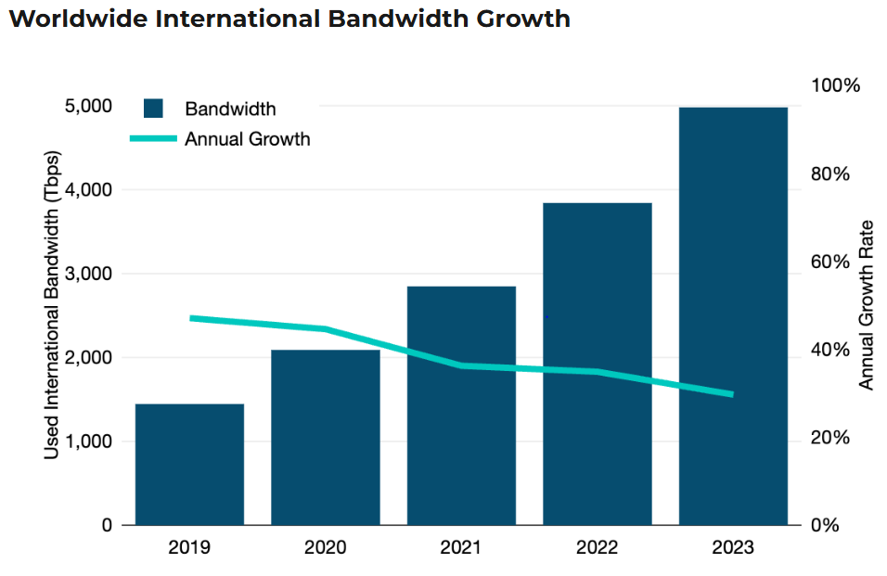
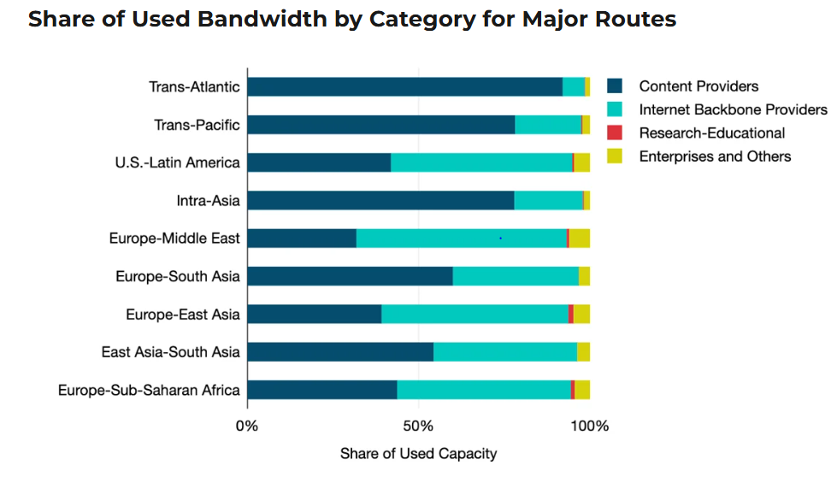
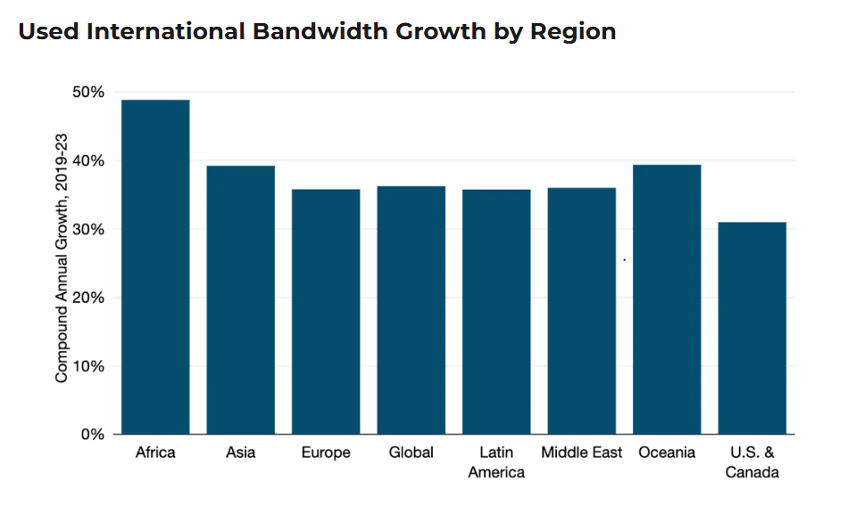
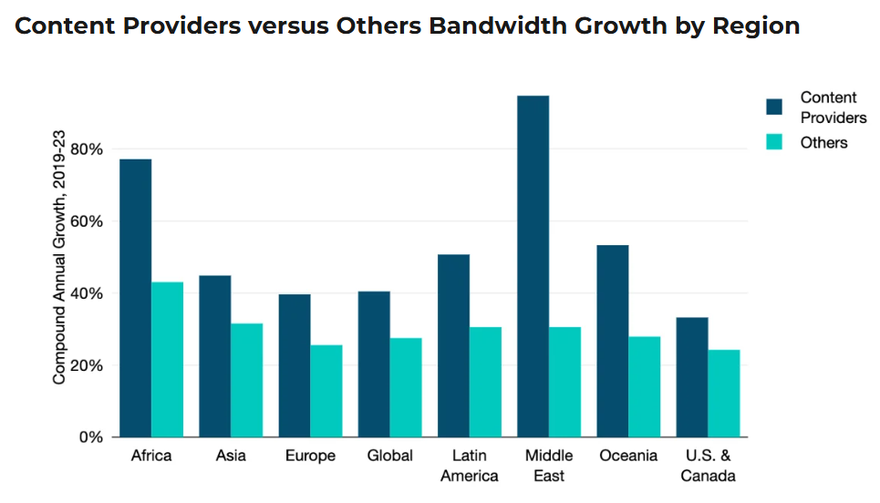
Content Providers Driving Growth in International Bandwidth
Source: Used International Bandwidth Reaches New Heights by Alan Mauldin (TeleGeography)
Notes:
https://www.linkedin.com/pulse/nni-5g-roaming-from-ipx-ixp-abu-hayat-khan/
A (Refreshed) List of Content Providers' Submarine Cable Holdings
https://www.kentik.com/kentipedia/what-is-internet-peering/
https://www.arelion.com/knowledge-hub/what-is-guides/what-is-the-internet-backbone
Internet peering is a connection between two IP networks that allow traffic to flow from sources in either of the networks to destinations in the other without allowing traffic to flow to destinations traversing the peer—or in other words, to travel via the internet.
Peering is configured using BGP (Border Gateway Protocol) which exchanges routing information between two systems, defined by their Autonomous System Numbers (ASNs). The configuration of BGP on both sides of the connection determines whether the connection is a “peering” or an “internet access/transit” type of connection.

Slide 6
Increase in International Internet Bandwidth
Source: TRA Market Research Data 2024
Notes:
International Internet bandwidth refers to the total used capacity of international Internet bandwidth, in bits per second per Internet user. Used international Internet bandwidth refers to the average traffic load (expressed in Mbit/s) of international fiber-optic cables and radio links for carrying Internet traffic.
Glossary | DataBank

Slide 7
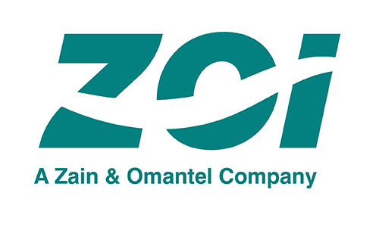
Key Developments in the past 5 years
MC1 IBX 2020
Local Zone 2023
ZOI
2023
Oman IX 2023
SN1 IBX 2024
More than half of the 21 subsea cables that connect to the GCC land in Muscat. The Muscat MC1 IBX® connects to more than 120 cities.
With five redundant landing stations and four terrestrial networks connected via border crossings, ZOI is positioned to be a global connectivity hub.
The new facility in Salalah enhances global connectivity, providing a strategic link between Asia, Africa, Europe, and Australia by shortening the routes of multiple subsea cables.
The Direct Connect service enables you to establish a private, physical network connection between AWS and your data center
Internet Peering service facilitates direct network interconnections, bringing all networks closer and localizing traffic.
Notes:
https://www.equinix.com/data-centers/europe-colocation/oman-colocation/muscat-data-centers
https://aws.amazon.com/about-aws/whats-new/2023/03/aws-direct-connect-muscat-oman/
om-ix.com
https://www.arelion.com/

Slide 8
Regulation (1/3) – International Telecommunications Cables
Streamline Application Process
Rules & Regulations for Landing & Transiting Cables
Timeline for Application Processing
Application Fee & Charges
Advance Permits for Cable Repair & Maintenance
Guidelines for Cable Protection
Regulations on International Telecommunications Cables – In Draft Stage

Slide 9
Regulation (2/3) – RAIO
Determine Dominance in the Wholesale Market
Addition of New Services in Reference Offers
Higher Capacity Options
Access to Passive Infrastructure
Dark Fiber (IRU)
Virtual Unbundling Local Access (VULA)
Cross Connect Links at PoP
Leased Lines Services & IPLC Offer 1G, 10G, 100G
Review of Wholesale Service Charges
KPIs & SLAs
Improve Performance & Efficiency
Compensation Measures
Review of RAIO – In Draft Stage

Slide 10
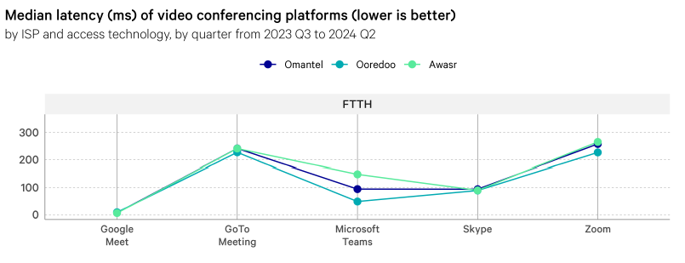
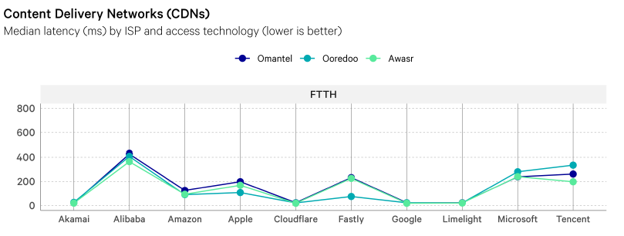
Regulation (3/3) – QoS Assessment
Latency to Google Meet is lower than to other video conferencing platforms, varying between 8 ms and 47 ms by ISP and technology.
In contrast, median latency to other video conferencing applications varies between 49 ms and 278 ms by ISP and technology, with GoTo Meeting (243 ms) and Zoom (259 ms) having the highest average latencies.
Latency to Microsoft Teams decreased between 2023 Q3 to 2024 Q4 for all Omantel and Awasr access technologies.
Latency was lower to some CDNs than others. Cloudflare, Google, and Limelight had average latencies between 19 – 86 ms, varying by ISP and access technology.
Alibaba and Tencent had the highest average latencies (413 ms and 348 ms, respectively). This pattern remained consistent across all four quarters from 2023 Q3 to 2024 Q4.
Reference: Executive Summary Report Year 1: Measuring Broadband Oman (SamKnows - Cisco)

